Slide 1

Unit-2 Sensors, Microcontrollers and their Interfacing
IOT and Applications
GTU # 3160716
Prof. Tushar J. Mehta
Computer Engineering Department
tushar.mehta@darshan.ac.in
+91-8866756776

Slide 2
Microcontrollers
Section - 1

Slide 3
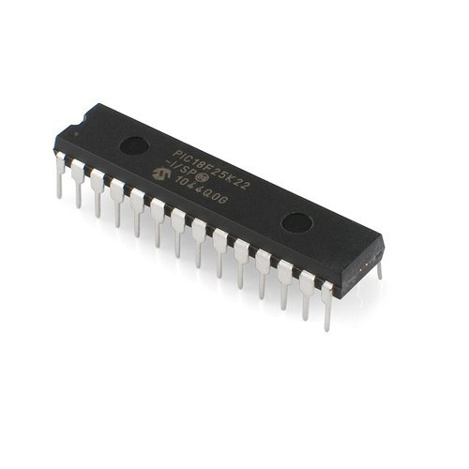
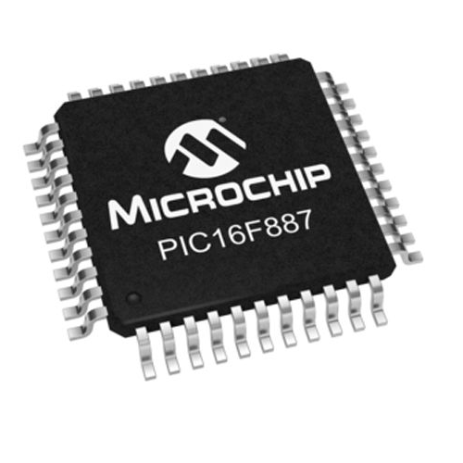
Overview of Microcontrollers
Microcontroller is a digital device consisting of CPU, peripheral I/Os, memories, interrupts, etc. in a single chip or IC.
Microcontroller is a compact integrated circuit designed for a specific operation in an embedded system.
The examples of various microcontrollers are given as:
Atmel AVR | Microchip – PIC | Intel 8051
AtMega8 | PIC18F452 | AT89C51
AtMega328P | PIC16F877 | AT89S52
AtMega16 | PIC16F676 | AT89c2051
AtMega2560 | PIC16F72 | P89V51

Slide 4
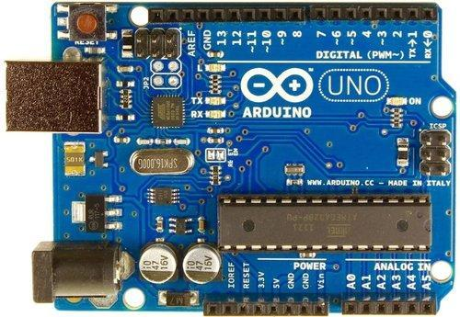
Introduction to Arduino Uno
Atmega328p Microcontroller inside
The operating voltage is 5V which is given by
USB socket or
External power socket
DC Current for each input/output pin is 40 mA
Digital input/output pins are 14 to interface digital input or output devices
There are 6 Analog i/p pins used for interfacing analog input devices.
What is Digital and Analog?
Memory Components:
32KB flash (program) memory
SRAM is 2 KB
EEPROM is 1 KB
USB Socket
Digital Pins
External Power socket
Atmega328p
Analog Pins

Slide 5
Components in Arduino Uno
Atmega328p Microcontroller: The heart of the board.
On-board LED interfaced with pin 13.
Power LED: Indicates the status of Arduino whether it is powered or not.
GND and 5V pins: Used for providing +5V and ground to other components of circuits.
TX and RX LEDs: These LEDs indicate communication between Arduino and computer.
Reset button: Use to reset the ATmega328P microcontroller
6
2
3
5
4
1

Slide 6
Sensors and Their Interfacing
Section - 2

Slide 7
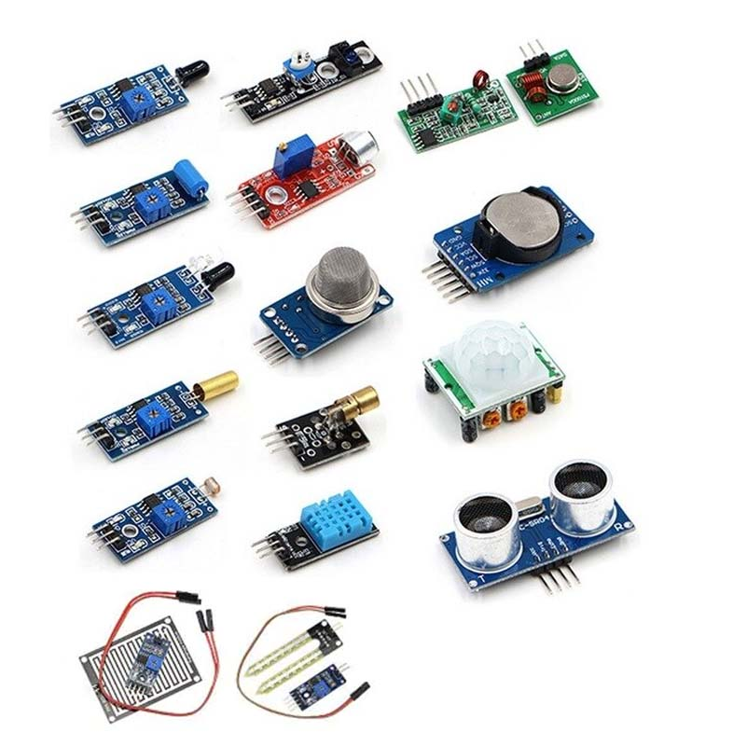
Definition of Sensor
Sensor is a device that detects or measures a physical property and records, indicates, or otherwise responds to it.
A sensor is a device that measures physical input from its environment and converts it into data that can be interpreted by either a human or a machine.
Normally, the sensors are input devices and there are two types of sensors.
Analog Sensors
Digital Sensors

Slide 8
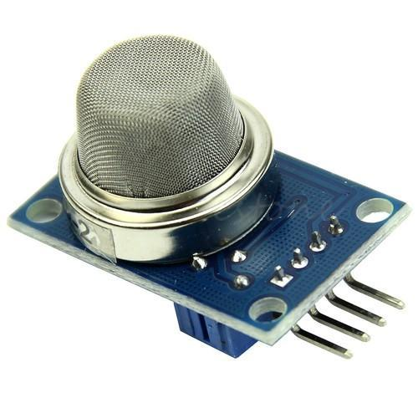
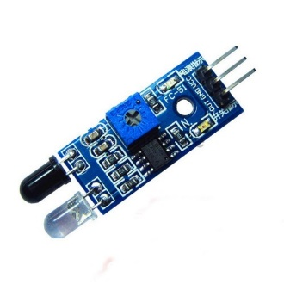
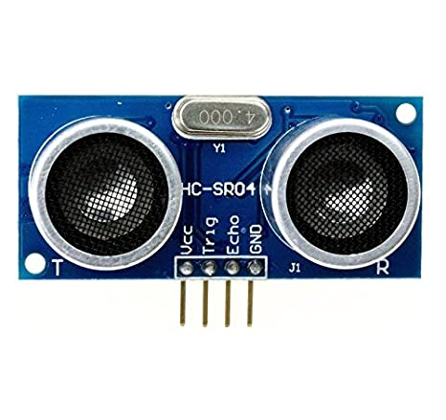
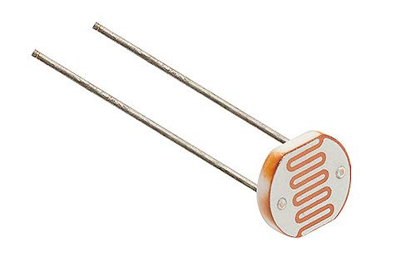
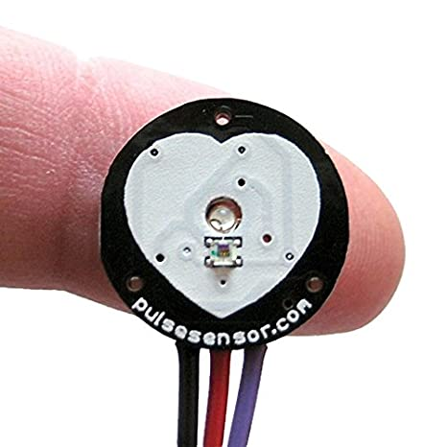
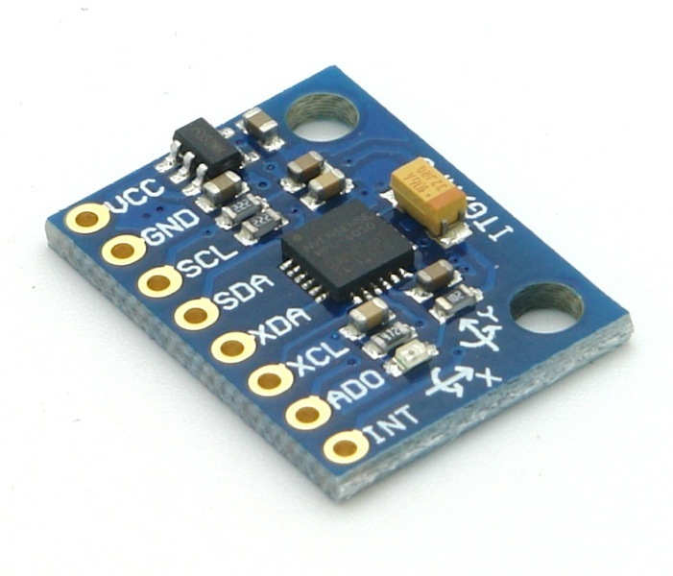
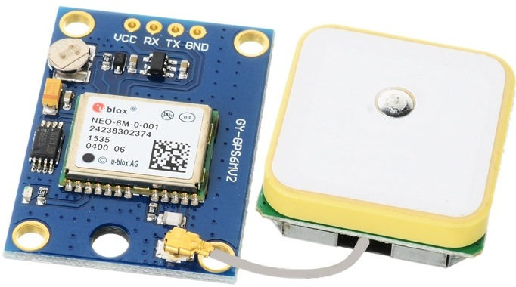
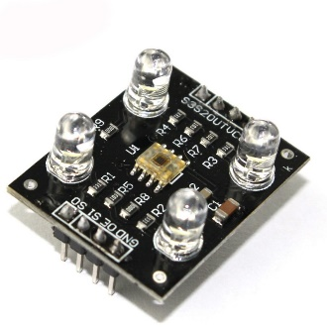
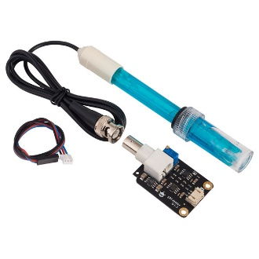
List of Sensors
The list of sensors which is to be covered in the chapter is as follows:
MQ-02/05 Gas Sensor
Obstacle Sensor
Ultrasonic Distance Sensor
LDR Sensor
Heartbeat Sensor
Gyro Sensor
GPS Sensor
Color Sensor
pH Sensor

Slide 9
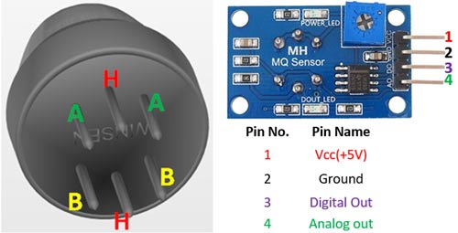
MQ-02/05 Gas Sensor
MQ -02 sensor is used to detect smoke.
H2, LPG, CH4 alcohol and smoke can be detected by MQ-02.
MQ-05 is not sensitive to smoke, hence less used in the application.
Pinout of MQ-02 sensor module are
Vcc – Connected to 5V
Gnd – Connected to ground
D0 – Digital output pin
A0 – Analog output pin

Slide 10
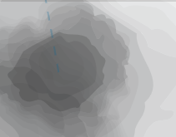

MQ-02/05 Gas Sensor – Working principle
When any flammable gas passes through the coil of the sensor, the coil burns and internal resistance decreases.
This results in an increased voltage across it. Hence we get variable voltage at A0 pin of MQ-05 gas sensor.
If gas present -> voltage is high.
If gas is not present -> voltage is low.
Smoke/Gas
MQ-05 Gas Sensor
Variable Voltage

Slide 11
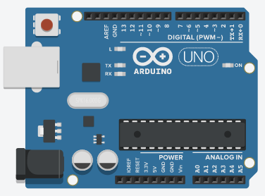
MQ-02/05 Gas Sensor – Interfacing with Arduino
The interfacing of MQ-02 with Arduino Uno is as shown in the figure.
Here, Vcc and Gnd pins of MQ-02 are connected to 5V and GND of Arduino board.
We want to take the input from a Gas sensor in an analog format so pin A0 is connected to one of the analog pins of Arduino i.e. A0.

Slide 12
MQ-02/05 Gas Sensor – Code explanation
The code in Arduino for MQ-02 gas sensor can be written as following
gas_sensor.ino
1
2
3
4
5
6
7
8
9
10
11
12
int gas_level;
void setup() {
pinMode(A0, INPUT);
Serial.begin(9600);
}
void loop() {
gas_level = analogRead(A0);
Serial.print("Gas Level : ");
Serial.println(gas_level);
delay(500);
}
Initialize the serial communication between Arduino and computer with baud rate 9600.
Reads the analog value from specified pin and stores it in the mentioned variable.
Prints data on the serial port in ASCII text given in double quotes.
Prints the data of specified variable on the serial port and also prints new line at the end.

Slide 13
Functions in Arduino IDE
Serial.begin( ): It is used to start serial communication between Arduino board and other device. Normally, it is connected with computer for monitoring the data. Serial communication uses pin 0 and 1 also working as Rx and Tx respectively.
Syntax : Serial.begin(baud_rate)
Parameters :
baud_rate: It defines the speed of data transfer rate between Arduino and other device. It is compulsory to set this baud rate same at both the side for proper transfer of data.
Serial.print( ) : Print the data from Arduino to other device.
Syntax : Serial.print(“text”)
Parameters :
The text which is to be printed by Arduino board is written in double quote so as to convert it in its ASCII values.
Serial.println( ) : Print the data with newline from Arduino to other device.
Syntax : Serial.println(“text”)
Parameters :
The text which is to be printed by Arduino board is written in double quote so as to convert it in its ASCII values.

Slide 14
Functions in Arduino IDE (Cont.)
analogRead( ): The syntax reads analog value from specified pin and converts it into 1024 levels or in 0 to 1023 range. The values is stored into specified variable in the code statement. The value is converted into 1024 levels because Arduino has 10 bit built in A-D converter unit.
Syntax : analogRead(pin)
Parameters :
pin: The Arduino analog pin number.

Slide 15
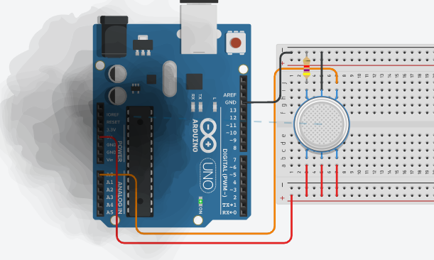
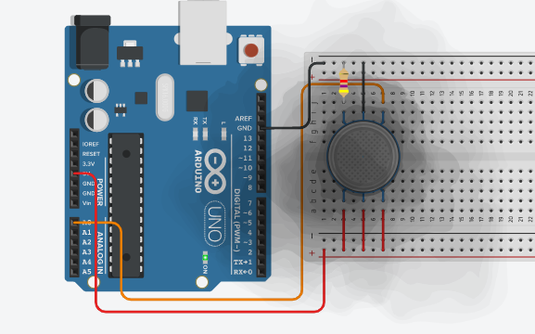
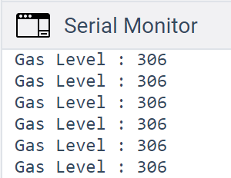
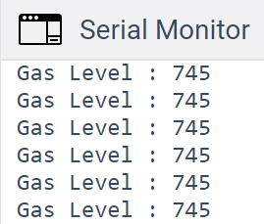
MQ-02/05 Gas Sensor – Output

Slide 16
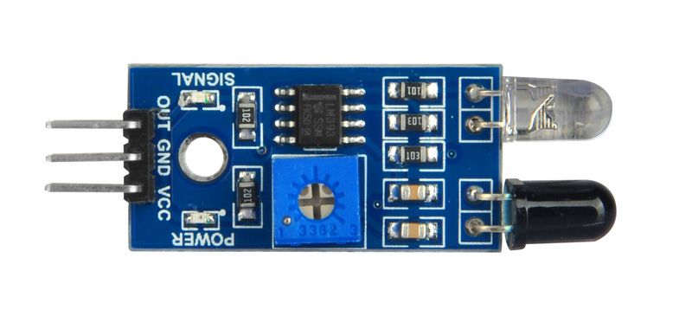
Obstacle Sensor
Obstacle sensor is used for detection of obstacle.
It is a digital sensor, hence gives binary output ‘1’ or ‘0’.
The range for detection of obstacle can be changed by potentiometer given.
Pinout of obstacle sensor module are
Vcc – Connected to 5V
Gnd – Connected to ground
Out/D0 – Digital output pin

Slide 17


Obstacle Sensor – Working principle
IR emitter transmits IR signals and IR receiver receives those signals from reflection.
If the obstacle is present then the transmitted signals are reflected back by obstacle and if they have amplitude greater then threshold the output signal will be ‘0’.
If the obstacle is not present then the transmitted signals are not reflected and the output signal will be ‘1’.
Obstacle in the way
Obstacle IR Sensor
Digital Output

Slide 18
Obstacle Sensor – Interfacing with Arduino
The interfacing of obstacle sensor with Arduino Uno is as shown in figure.
Here, Vcc and Gnd pins of obstacle sensor is connected to 5V and Gnd of Arduino board.
The output of obstacle sensor is in digital form. So it is connected to digital pin 2 of Arduino.

Slide 19
Obstacle Sensor – Code explanation
The code in Arduino for Obstacle sensor can be written as following:
obstacle-detect.ino
1
2
3
4
5
6
7
8
9
10
11
12
13
14
int obstacle_pres=0;
void setup() {
pinMode(2, INPUT);
pinMode(13, OUTPUT);
Serial.begin(9600);
}
void loop() {
obstacle_pres = digitalRead(2);
if (obstacle_pres == LOW)
{
Serial.print("Obstacle is present");
digitalWrite(13,HIGH);
}
Reads the digital data from specified pin and stores it into given variable.

Slide 20
Obstacle Sensor – Code explanation (Cont.)
obstacle-detect.ino
13
14
15
16
17
18
else
{
digitalWrite(13,LOW);
}
delay(1000);
}
digitalRead( ) : Reads digital data from specified pin and stores it into given variable.
Syntax : digitalRead(pin)
Parameters :
Pin : The Arduino digital pin number.

Slide 21
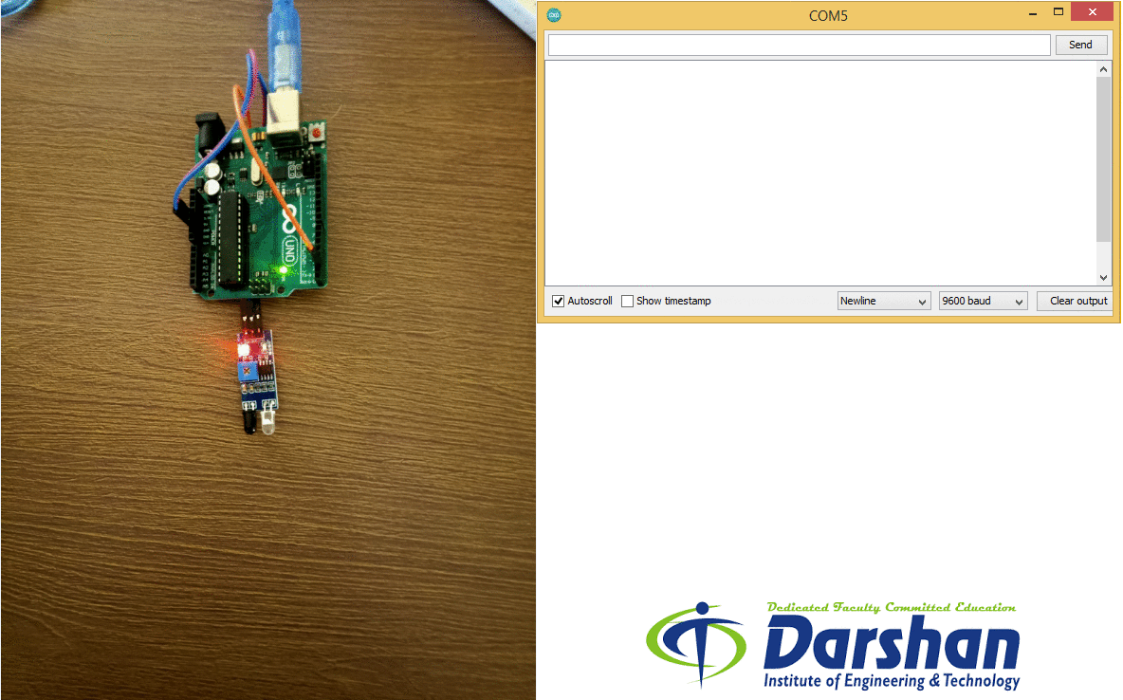
Obstacle Sensor – Output

Slide 22
HC-SR04 Ultrasonic Sound Sensor
Ultrasonic Sound Sensor is used to measure the distance of an object.
The sensor can only measure the distance of object. It can not identify the type of object.
It is also known as Ultrasonic distance sensor.
Pinout of HC-SR04 module are
Vcc – Connected to 5V
Gnd – Connected to ground
Trigger – Generates the transmit pulse
Echo – Receives echo from obstacle

Slide 23
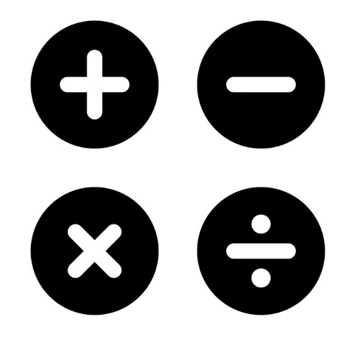
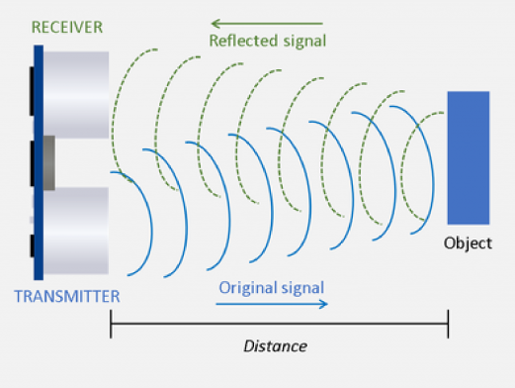
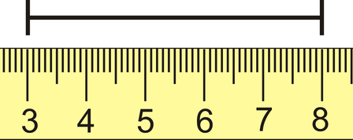
HC-SR04 Ultrasonic Sound Sensor – Working principle
The emitter transmits ultrasonic sound waves which are reflected by near by objects.
The reflected pulse is received by sensor.
Some mathematical operations are performed to obtain the distance value.
The distance value is converted into desired unit.
Ultrasonic waves
Mathematical operations
Measurement of distance

Slide 24
HC-SR04 Ultrasonic Sound Sensor– Interfacing with Arduino
The interfacing of HC-SR04 sensor with Arduino Uno is as shown in figure.
Here, Vcc and Gnd pins of HC-SR04 sensor are connected to 5V and Gnd of Arduino board.
The trigger and echo pin is connected to (any) digital pins of Arduino board.
In this case, trigger is connected to 11 and echo is connected to 12.

Slide 25
HC-SR04 Ultrasonic Sound Sensor – Code explanation
The code in Arduino for HC-SR04 Ultrasonic Sound Sensor can be written as following
Distance-measure.ino
1
2
3
4
5
6
7
8
9
10
11
12
13
14
15
int trigPin = 11; // Trigger
int echoPin = 12; // Echo
long duration, cm, inches;
void setup() {
Serial.begin (9600);
pinMode(trigPin, OUTPUT);
pinMode(echoPin, INPUT);
}
void loop() {
digitalWrite(trigPin, LOW);
delayMicroseconds(5);
digitalWrite(trigPin, HIGH);
delayMicroseconds(10);
digitalWrite(trigPin, LOW);
Generates the delay of specified microseconds.

Slide 26
HC-SR04 Ultrasonic Sound Sensor – Code explanation (Cont.)
Distance-measure.ino
Reads a HIGH pulse on specified pin and returns the value of time in microsecond for transition from LOW to HIGH.
16
17
18
19
20
21
22
23
24
25
26
27
28
29
pinMode(echoPin, INPUT);
duration = pulseIn(echoPin, HIGH);
// Convert the time into a distance
cm = (duration/2) / 29.1;
inches = (duration/2) / 74;
Serial.print(inches);
Serial.print("in, ");
Serial.print(cm);
Serial.print("cm");
Serial.println();
delay(250);
}
Distance(m) = Speed (m/s)x Time (s)
But, Time of pulse we receive is in µs and distance we want to find is in cm.
Distance(cm) = Speed (cm/µs) x Time (µs)
Speed of sound is 343m/s which is converted into 0.0343 cm/µs.
So either we have to multiply 0.0343 or divide 29.1

Slide 27
Functions in Arduino IDE
delayMicroseconds( ): It pauses the program for amount of time in microseconds specified as the parameter.
Syntax : delayMicroseconds(μs)
Parameters :
μs : The number of microseconds to pause.
pulseIn( ) : Reads a pulse HIGH or LOW from specified pin and wait for the time to go the pulse from HIGH to LOW or LOW to HIGH. It returns the time required to transit the pulse in variable.
Syntax : pulseIn(pin, value)
Parameters :
Pin: The number of the Arduino pin on which you want to read the pulse.
Value: The type of pulse that you want to read.

Slide 28
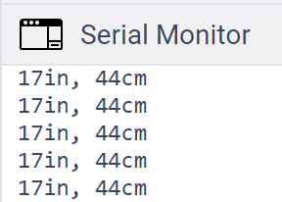
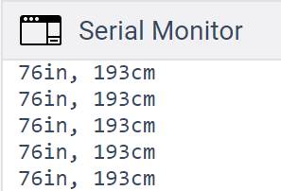
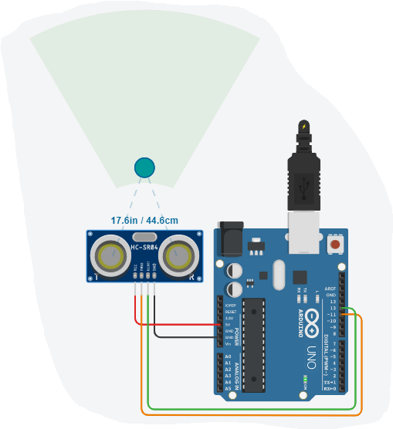
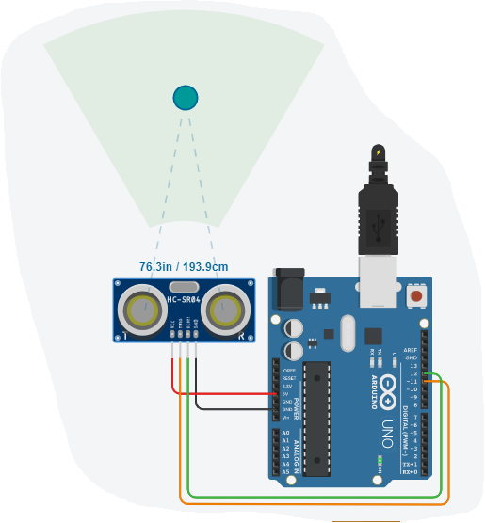
HC-SR04 Ultrasonic Sound Sensor – Output

Slide 29
LDR Sensor
LDR is known as Light Dependent Resistor.
The internal resistance of LDR changes with respect to light intensity.
Normally LDR works with voltage divider network.
The LDR is used in the application where the task is performed with light intensity as input.

Slide 30
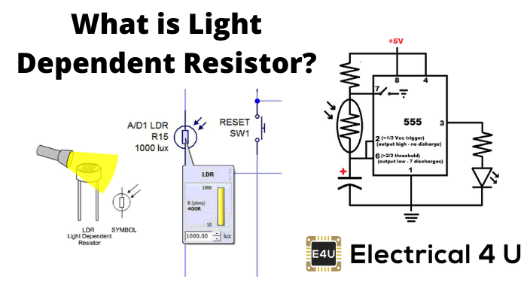
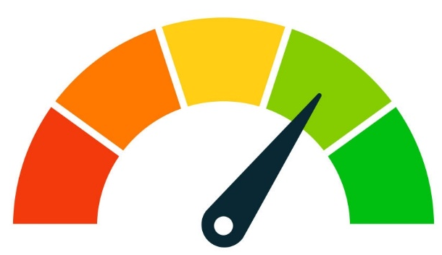
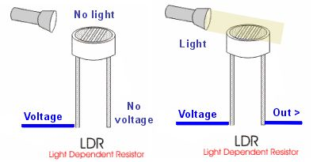
LDR Sensor – Working principle
The LDR works on principle of Ohm’s law.
As the light intensity on LDR is higher, the resistance of LDR decreases.
The decreased resistance will drop more voltage across LDR according to Ohm’s Law.
The presence of light can be identified by the value of voltage across LDR.
Light Intensity to be measured
Output voltage measurement
Calculate the intensity

Slide 31
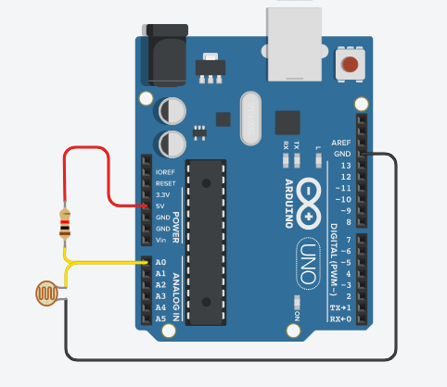
LDR Sensor– Interfacing with Arduino
The interfacing of LDR sensor with Arduino Uno is as shown in figure.
Here, one terminal of 10kΩ resistor is connected to 5V of Arduino and second terminal is connected to A0 pin.
One terminal of LDR is connected to A0 pin of Arduino and other is connected to Gnd.
This creates a voltage divider network between fixed resistor and LDR.
The voltage at A0 pin remains near to 5V when LDR is in dark (high resistance).
The voltage at A0 pin remains near to 0V when LDR is in Bright light (low resistance).

Slide 32
LDR Sensor – Code explanation
The code in Arduino for LDR Sensor can be written as following
Light-intensity-measure.ino
1
2
3
4
5
6
7
8
9
10
11
12
13
void setup()
{
pinMode(A0, INPUT);
Serial.begin(9600);
}
void loop()
{
int light_intensity = analogRead(A0);
if (light_intensity > 800)
{
Serial.println(“Darker");
}

Slide 33
LDR Sensor – Code explanation (Cont.)
Light-intensity-measure.ino
16
17
18
19
20
21
else if (light_intensity < 500)
{
Serial.println(“Too Bright");
}
delay(1000);
}

Slide 34
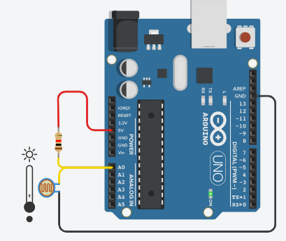
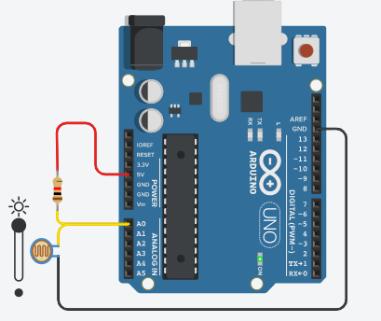
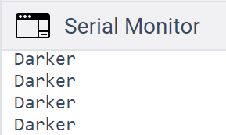
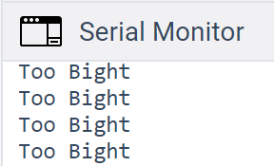
LDR Sensor – Output

Slide 35
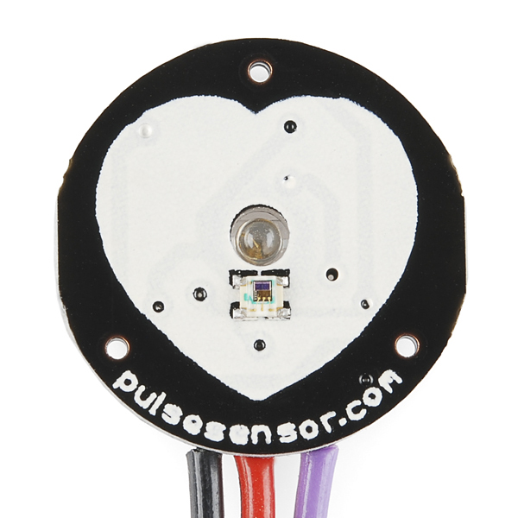
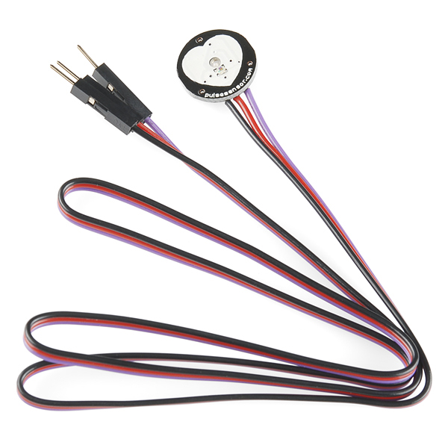
Heartbeat Sensor
Heartbeat sensor is having typical application in health care domain.
This is mainly used in wearable devices to monitor the heart beat / heart rate of the person.
The sensor is inexpensive and generates square waves for each pulse. The averaging of pulses gives analog voltage according to the heartbeat.
Pinout of heartbeat sensor module are
Vcc – Connected to 5V
Gnd – Connected to ground
A0 – Analog output pin

Slide 36
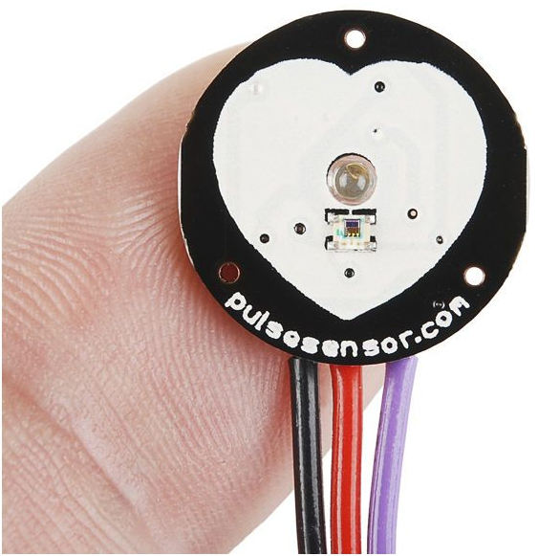
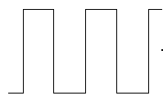

Heartbeat Sensor – Working principle
The sensor senses the heartbeat as per blood circulation in the body.
It generates the output pulse signal according to the rate at which heart beats.
The output pulses are considered as PWM waves. Hence they are converted into analog signals.
This analog signal is converted to digital which gives the output beat rate.
Heartbeat input
Generation of Digital Pulse
as output
Calculates the BPM

Slide 37
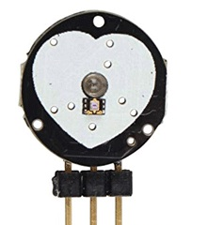
Heartbeat Sensor – Interfacing with Arduino
The interfacing of Heartbeat sensor with Arduino Uno is as shown in the figure.
Here, Vcc and Gnd pins of heartbeat sensor are connected to 5V and GND of Arduino board.
We want to take the input from the sensor in an analog format so the signal pin of the sensor is connected to one of the analog pins of Arduino i.e. A0.

Slide 38
Heartbeat Sensor – Code explanation
The code in Arduino for Heartbeat sensor can be written as following:
Heartbeat_sensor.ino
1
2
3
4
5
6
7
8
9
10
11
12
13
int UpperThreshold = 518;
int LowerThreshold = 490;
int reading = 0;
float BPM = 0.0;
bool IgnoreReading = false;
bool FirstPulseDetected = false;
unsigned long FirstPulseTime = 0;
unsigned long SecondPulseTime = 0;
unsigned long PulseInterval = 0;
void setup(){
Serial.begin(9600);
}

Slide 39
Heartbeat Sensor – Code explanation (Cont.)
Heartbeat_sensor.ino
14
15
16
17
18
19
20
21
22
23
24
25
26
27
28
29
void loop(){
reading = analogRead(0);
if(reading > UpperThreshold
&& IgnoreReading == false){
if(FirstPulseDetected == false){
FirstPulseTime = millis();
FirstPulseDetected = true;
}
else{
SecondPulseTime = millis();
PulseInterval = SecondPulseTime - FirstPulseTime;
FirstPulseTime = SecondPulseTime;
}
IgnoreReading = true;
}
millis( ) function gives the time in millisecond from where the Arduino board powered or reset.

Slide 40


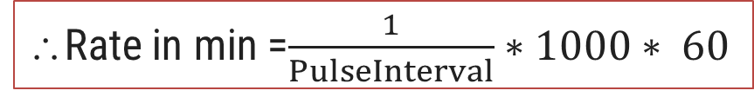

Heartbeat Sensor – Code explanation (Cont.)
Heartbeat_sensor.ino
PulseInterval is in milliseconds.
∴Rate = 1/Time
30
31
32
33
34
35
36
37
38
if(reading < LowerThreshold){
IgnoreReading = false;
}
BPM = (1.0/PulseInterval) * 60.0 * 1000;
Serial.print(BPM);
Serial.println(" BPM");
Serial.flush();
}
∴Rate =$\frac{1}{PulseInterval(ms)}$
∴Rate =$\frac{1}{{PulseInterval (s)}/{1000}}$
∴Rate =$\frac{1}{PulseInterval(s)}∗1000$
∴Rate in min =$\frac{1}{PulseInterval}∗1000∗ 60$
millis( ) : Returns the number of milliseconds passed since the Arduino started running the current program.
Syntax : millis( )

Slide 41
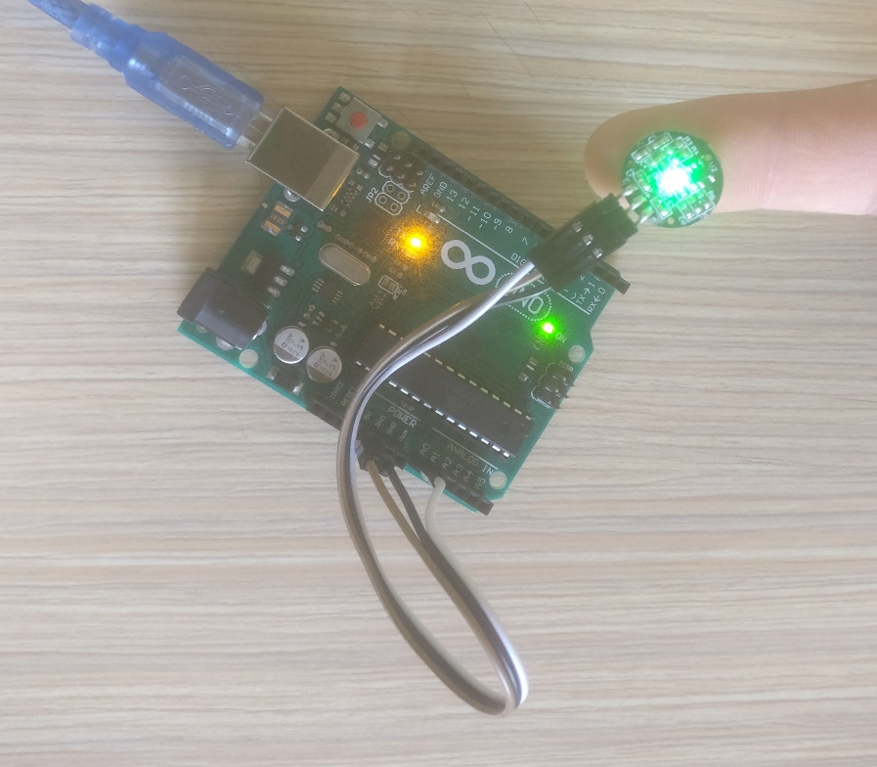
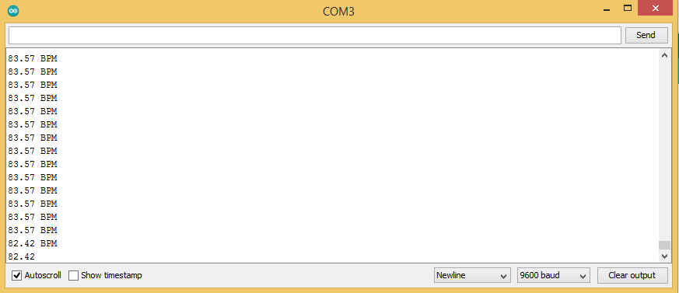
Heartbeat Sensor – Output

Slide 42
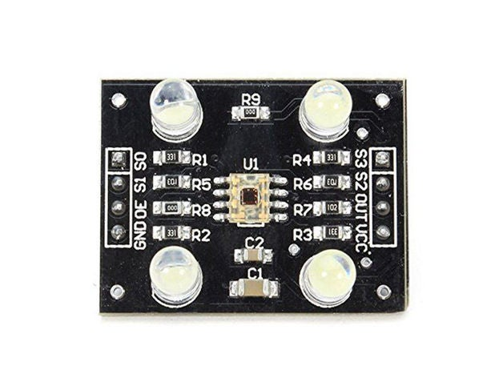
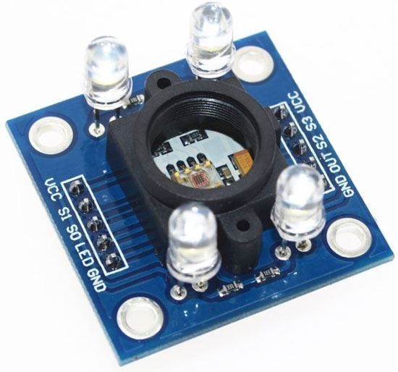
Colour Sensor
Colour sensor is used to detect the RGB colour coordinates of a particular colour.
The colour sensor module has TSC3200 IC that converts colour to frequency by enabling a particular colour diode turn by turn.
The colour sensor is mainly used in the application where the objects are identified by their colour.
Pinout of colour sensor module are
Vcc – Connected to 5V
Gnd – Connected to ground
S0, S1 – Used for output frequency scaling
S2, S3 – Type of photodiode selected
(OE)’ – Enable for output
OUT – Output frequency (f_{o})

Slide 43
Colour Sensor (Cont.)
The combination of S0 and S1 are used for output frequency scaling.
The different microcontrollers have different counter functionality and limitations. Hence, we need to scale the frequency according to microcontroller used.
The percentage of output scaling for different combinations of S0 and S1 are shown in the table.
The S3 and S4 pins are used for photodiode selection. The photodiodes are associated with different colour filters.
The table shows combinations of S3 and S4 for different photodiodes.
S0 | S1 | Output Frequency Scaling (f₀) | Typical full-scale Frequency
L | L | Power Down | ———
L | H | 2% | 10 – 12 KHz
H | L | 20% | 100 – 120 KHz
H | H | 100% | 500 – 600 KHz
S3 | S4 | Photo Diode Type
L | L | Red
L | H | Blue
H | L | Clear(No Filter)
H | H | Green

Slide 44
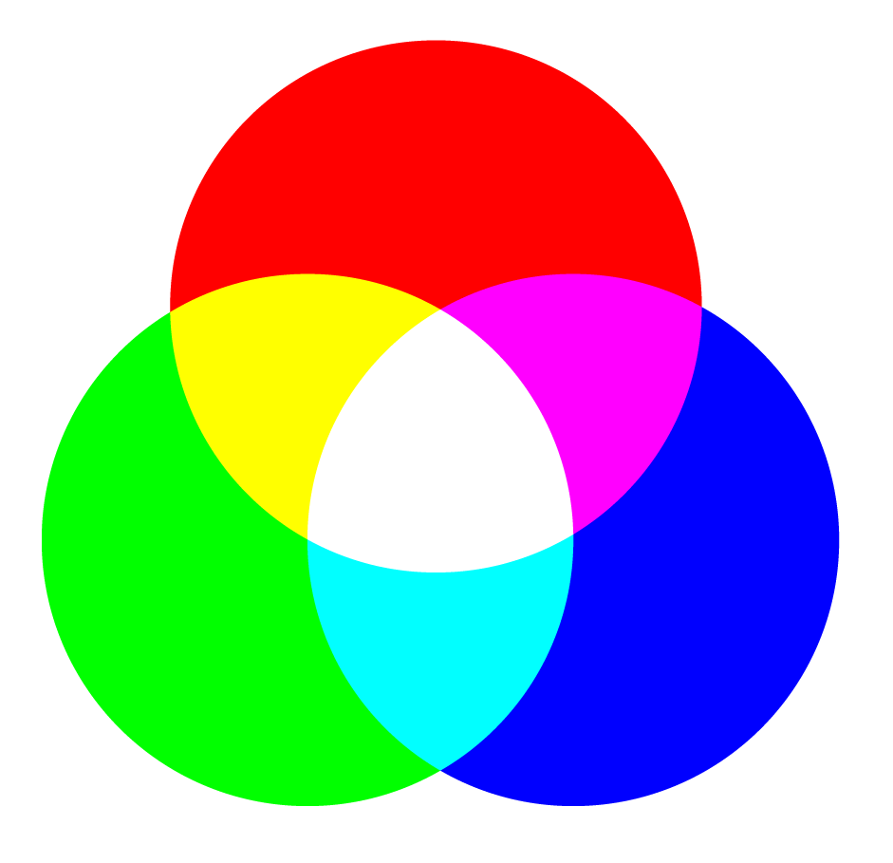
Colour Sensor – Working principle
The sensor works by imparting a bright light on an object and recording the reflected colour by the object.
The selected photodiode for colour of red, green and blue converts the amount of light to current.
These RGB values are further processed to identify the exact colour combination.
Input to photodiode
of colour sensor
Output RGB colour values
Calculation of actual
colour of object

Slide 45
Colour Sensor – Interfacing with Arduino
The interfacing of Colour Sensor with Arduino Uno is as shown in figure.
Here, Vcc and Gnd pins of Colour Sensor are connected to 5V and Gnd of Arduino board.
As we need to enable the sensor OE’ is connected to GND.
All selection pins S0, S1 S2 and S3 are connected to digital pins of Arduino that is 9,8,11 and 12 respectively.
The output of colour sensor are taken as a pulse count. So OUT pin is also connected to digital pin. In our case it is connected to pin 10.

Slide 46
Colour Sensor – Code explanation
The code in Arduino for Colour sensor can be written as following:
Colour_sensor.ino
1
2
3
4
5
6
7
8
9
10
11
12
13
14
15
#define s0 9
#define s1 8
#define s2 11
#define s3 12
#define out 10
int frequency=0;
void setup()
{
pinMode(s0,OUTPUT);
pinMode(s1,OUTPUT);
pinMode(s2,OUTPUT);
pinMode(s3,OUTPUT);
pinMode(out,INPUT);

Slide 47
Colour Sensor – Code explanation (Cont.)
Colour_sensor.ino
16
17
18
19
20
21
22
23
24
25
26
27
28
29
30
Serial.begin(9600);
digitalWrite(s0,HIGH);
digitalWrite(s1,HIGH);
}
void loop()
{
digitalWrite(s2,HIGH);
digitalWrite(s3,HIGH);
frequency = pulseIn(out,LOW);
frequency = map(frequency, 30,90,255,0);
Serial.print("G = ");
Serial.print(frequency);
Serial.print("\t");
delay(100);
This syntax maps the value of given number or variable from its defined range to desired range.

Slide 48
Colour Sensor – Code explanation (Cont.)
Colour_sensor.ino
31
32
33
34
35
36
37
38
39
40
41
42
43
44
45
46
47
digitalWrite(s2,LOW);
digitalWrite(s3,HIGH);
frequency = pulseIn(out,LOW);
frequency = map(frequency,25,70,255,0);
Serial.print(“B = ");
Serial.print(frequency);
Serial.print("\t");
delay(100);
digitalWrite(s2,LOW);
digitalWrite(s3,HIGH);
frequency = pulseIn(out,LOW);
frequency = map(frequency,10,56,255,0);
Serial.print(“R = ");
Serial.print(frequency);
Serial.print("\t");
delay(100);
}

Slide 49
Functions in Arduino IDE
map( ): The syntax maps a number from one range to another.
Syntax : map(value, fromLow, fromHigh, toLow, toHigh)
Parameters :
value: the number or variable to map.
fromLow: the lower bound of the value’s current range.
fromHigh: the upper bound of the value’s current range.
toLow: the lower bound of the value’s target range.
toHigh: the upper bound of the value’s target range.

Slide 50

GPS Sensor
GPS sensor is used to get the location data of the place where sensor is situated.
The data from sensor is acquired in National Marine Electronics Association (NEMA) format. The format is used by marine department for communication.
There are multiple variants of GPS sensors available in the market. We can select based on our requirements.
Here, the given sensor is GY-GPS6MV2 as shown in the image.
Pinout of GPS sensor module are
Vcc – Connected to 5V
Gnd – Connected to ground
Tx – Serial Data Transmit
Rx – Serial Data Receive

Slide 51
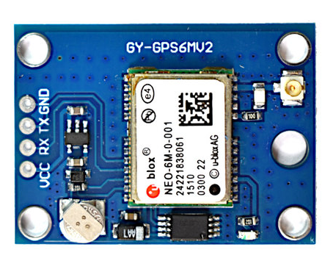

GPS Sensor – Working principle
The sensor is placed in the system whose location is to be tracked.
The GPS device communicates with GPS satellite and the satellite returns its current location in form of latitude and longitude.
The sensor transmits the data to the microcontroller in a predefined format from which we can extract the tracked location.
Latitude
Longitude
GPS device with antenna
for communication
Returns latitude and longitude
as output
Tracked Location

Slide 52
GPS Sensor – Interfacing with Arduino
The interfacing of GPS Sensor with Arduino Uno is as shown in figure.
Here, Vcc and Gnd pins of GPS Sensor are connected to 5V and Gnd of Arduino board.
As the GPS communicates with Arduino serially, we need to connect Tx and Rx pin of GPS with serial pins of Arduino.
But, we want the data received from the GPS sensor in serial monitor also to read the current location.
Therefore, we need to use any digital pins of Arduino as serial transmit and receive pins which is done by software serial.
Here, the Tx and Rx pins of GPS are connected with pins 3 and 2 respectively.

Slide 53
GPS Sensor – Code explanation
The code in Arduino for GPS sensor can be written as following:
GPS_sensor.ino
1
2
3
4
5
6
7
8
9
10
11
12
13
#include <TinyGPS++.h>
#include <SoftwareSerial.h>
static const int RXPin = 3, TXPin = 2;
static const uint32_t GPSBaud = 9600;
TinyGPSPlus gps;
SoftwareSerial ss(RXPin, TXPin);
void setup()
{
Serial.begin(115200);
ss.begin(GPSBaud);
}
Includes the TinyGPS++ library to use built in functions for reading GPS sensor.
Includes the SoftwareSerial library to use software serial communication
Defining gps as object of TinyGPSPlus
Defining ss as object of SoftwareSerial

Slide 54
GPS Sensor – Code explanation (Cont.)
GPS_sensor.ino
14
15
16
17
18
19
20
21
22
23
24
25
26
27
void loop()
{
while (ss.available() > 0)
gps.encode(ss.read());
displayInfo();
if (millis()>5000 && gps.charsProcessed()<10)
{
Serial.println("No GPS detected: Check wiring.");
while(true);
}
}
The syntax reads the data serially from GPS and gps.encode( ) function encodes that data as per the format.

Slide 55
GPS Sensor – Code explanation (Cont.)
GPS_sensor.ino
28
29
30
31
32
33
34
35
36
37
void displayInfo() {
Serial.print("Location: ");
if (gps.location.isValid())
{
Serial.print(gps.location.lat(), 6);
Serial.print(",");
Serial.print(gps.location.lng(), 6);
}
Serial.println();
}
gps.location.isValid( ) function returns “TRUE” if the location is in valid form
gps.location.lat( ) function returns the current latitude value and it is printed with 6 decimal point precision.
gps.location.lng( ) function returns the current longitude value and it is printed with 6 decimal point precision.

Slide 56
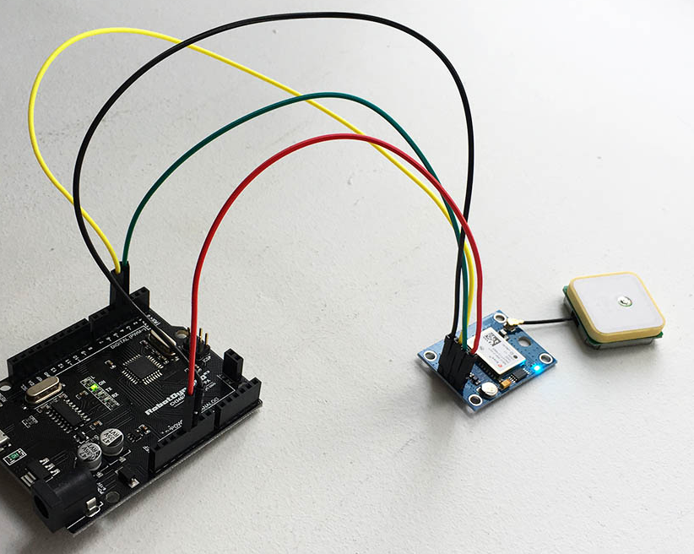


GPS Sensor – Output

Slide 57
Gyro Sensor
The Gyro sensor is very useful in wearable devices.
It is used to find the position or angle of rotation of the body.
It mainly senses
Rotational motion
Changes in orientation
The Gyro sensor communicates with microcontroller with I2C (Inter-Integrated Communication).
I2C is the most sophisticated two-wire communication protocol.
It works with the device address and its respective data frames.
Normally, I2C is used when more numbers of devices are connected.

Slide 58
Gyro Sensor (Cont.)
The pin out of Gyro sensor MPU6050 are as following.
Vcc – connected to 5V
GND – connected to ground
SCL – Serial Clock Line
SDA – Serial Data Line
XDA – Auxiliary Serial Data
XCL – Auxiliary Serial Clock
AD0 – This pin can be used to vary the address incase of multiple sensors used
INT – Interrupt pin available for certain application

Slide 59


MPU-6050 Gyro Sensor – working principle
The MPU 6050 senses the gravitational force applied to it.
Place the sensor in device whose inclination is to be measured.
Obtain the values of x, y and z coordinates.
Determine the elevation angle by performing mathematical caluculations
x,y,z : 507 506 617
x,y,z : 507 504 616
x,y,z : 506 505 617
x,y,z : 506 506 618
Sensor placed for
finding Inclination
x, y, and z coordinates
Determination of Angle

Slide 60

MPU-6050 Gyro Sensor – Interfacing with Arduino
The interfacing of MPU-6050 with Arduino Uno is as shown in figure.
Here, Vcc and Gnd pins of MPU6050 is connected to 5V and Gnd of Arduino board.
The SCL and SDA pins are used for I2C communication. These pins are available in Arduino with A5 and A4 pins as second functionality.
Hence, SCL and SDA are connected to A5 and A4 pins of Arduino.
The INT pin of MPU6050 gives interrupt when angular velocity increases than defined threshold value. So interrupt pin of MPU6050 is connected to external interrupt by Arduino supported at digital pin 2.

Slide 61

PH Sensor
The pH sensor is used to detect hydrogen ions concentration of a liquid.
pH sensor are mostly used in laboratories to test the acidity of solution.
By the use of pH sensor we can identify the pH of a solution and whether it is acid or base.

Slide 62


pH Sensor – Working principle
When this sensor is placed in a solution, the smaller ions penetrate the boundary area of glass and the lager ions remain in the solution. This creates potential difference.
The pH meter measures the difference in electrical potential between the pH electrodes.
The potential difference generates different analog values for different liquids.
By knowing the analog value of standard water, the pH value of other liquid can be determined.
pH Sensor with
Electrodes
Output Voltage
Determination of alkalinity
of the liquid

Slide 63

pH Sensor – Interfacing with Arduino
The interfacing of pH sensor with Arduino is as shown in figure.
Here, Vcc and Gnd pins of pH Sensor are connected to 5V and Gnd of Arduino board.
The output pin of pH sensor is connected to analog pin of Arduino.
The connection of pH sensor is done with voltage converter via BNC pin.

Slide 64
pH Sensor – Code explanation
The code in Arduino for pH sensor can be written as following:
PH_sensor.ino
1
2
3
4
5
6
7
8
9
10
11
#define SensorPin A0
#define Offset 0
unsigned long int avgValue;
float b;
int buf[10],temp;
void setup()
{
pinMode(SensorPin,INPUT);
Serial.begin(9600);
}
Defining offset for correction of pH value. The offset value can be obtained by measuring the pH of standard water.
Defining buf as an integer array.

Slide 65
pH Sensor – Code explanation (Cont.)
PH_sensor.ino
12
13
14
15
16
17
18
19
20
21
22
23
24
25
26
27
void loop()
{
for(int i=0;i<10;i++) {
buf[i]=analogRead(SensorPin);
delay(10);
}
for(int i=0;i<9;i++) {
for(int j=i+1;j<10;j++) {
if(buf[i]>buf[j])
{
temp=buf[i];
buf[i]=buf[j];
buf[j]=temp;
}
}
}
Taking 10 different values of analog voltage from the pin where sensor is connected
Sorting the elements of array buf in ascending order.

Slide 66
pH Sensor – Code explanation (Cont.)
PH_sensor.ino
28
29
30
31
32
33
34
35
36
37
38
39
avgValue=0;
for(int i=2;i<8;i++)
avgValue+=buf[i];
avgValue = avgValue/6;
float phValue=(float)((avgValue)*
5.0/1024);
phValue=3.5*phValue+Offset;
Serial.print("pH: ");
Serial.print(phValue,2);
Serial.println(" ");
delay(800);
}
Avoiding lower and upper two (total four) values of array and taking the average of elements of rest of the array.
Converting the average value into equivalent millivolts.
Converting millivolts to its equivalent pH values as given in datasheet and adjusting with offset.

Slide 67
Other Microcontrollers
Section - 3

Slide 68
8051 Microcontroller Architecture
8051 was built by Intel but other companies are also permitted to make 8051 microcontrollers with same features and compatible set of instructions.
External
Interrupt
Counter
Input
The diagram shows Architectural representation of 8051 microcontroller.
Interrupt Control
4K Flash
128 Byte RAM
Timer 1
Timer 0
CPU
Oscillator
Bus Control
I/O Ports
Serial Port
P0
P1
P2
P3

Slide 69
Features of 8051 Microcontroller
8- bit microcontroller.
Many general purpose and few special function registers (SFRs).
Two major 8 bit registers. A and B. Both are used in arithmetic operations mainly.
A is accumulator and it addressable.
There are 21 SFRs among them few are bit addressable. SFRs perform various dedicated operations.
Also, some control registers for timer, counter and interrupt fall in category of SFRs.
Four register banks having 8 registers in each bank.
Data pointer register which is 16 bit made from combinations of two 8 bit registers – DPH and DPL.
16 bit Program Counter.
8 bit Program Status Word(PSW) and used as Flag register.
Internal ROM and EPROM.
Internal user accessible RAM of 128 Bytes

Slide 70
Features of 8051 Microcontroller
There are four ports P0, P1, P2 and P3 that can be configured as input and output.
Two 16 bit timer/counter – T0 and T1.
Full duplex serial communication and dedicated serial buffer register SBUF.
Supports interrupt programming.
Oscillator and Clock circuits are built in.
Easier and simpler instruction set.

Slide 71
Memory organization in 8051
There are two categories of memory – program memory and data memory.
Program memory
In 8051, 4K bytes of program memory is available.
It is normally referred as ROM and non volatile in nature.
It is used to store following:
Boot up programs
Interrupt Service Routines (ISR)
Macro Functions
Data memory
Data memory is used to store temporary data.
8051 has 256 byte data memory neatly organized for various operations.
The 256 byte data memory is divided into two parts
First 128 Bytes – Internal user accessible RAM
Last 128 Bytes – Special Function Registers (SFRs).
Special function registers
(80 – FFh)
Internal RAM
(00 – 7Fh)
FFh
00h

Slide 72
R7
. . .
R0
1Fh
Register Bank 3
Data Memory Organization
18h
The first 32 Bytes 00h to 1Fh are allocated for register banks.
There are four register banks – register bank 0,1,2 and 3.
Each register bank has 8 registers R0 to R7.
Special function registers
(80 – FFh)
Internal RAM
(00 – 7Fh)
FFh
R7
. . .
R0
17h
Register Bank 2
10h
R7
. . .
R0
0Fh
Register Bank 1
08h
R7
. . .
R0
07h
Register Bank 0
1Fh
00h
00h
00h

Slide 73
Bit Addresses
b7 b6 b5 b4 b3 b2 b1 b0
7F 78
77 70
6F 68
60
5F 58
50
4F 48
47 40
3F 38
37 30
2F 28
27 20
1F 18
10
0F 08
07 00
2Fh
2Eh
2Dh
2C h
2Bh
2Ah
29h
28h
27h
26h
25h
24h
23h
22h
21h
20h
Data Memory Organization
20h to 2Fh are bit addressable RAM.
Each bit of each register can be set or reset.
The bits have also different address.
Special function registers
(80 – FFh)
Internal RAM
(00 – 7Fh)
FFh
Bit Addressable
2Fh
20h
00h

Slide 74
The last 80 bytes of Internal RAM that is 30h to 7Fh are used as General purpose RAM Area.
Any general purpose data is stored in this area.
Data Memory Organization
Special function registers
(80 – FFh)
Internal RAM
(00 – 7Fh)
FFh
General Purpose
RAM Area
80 Bytes
7Fh
7Fh
30h
30h
00h

Slide 75
Special Function Registers
There are 21 SFRs in 8051microcontroller.
They are important set of registers used for dedicated operations in 8051 microcontroller.
Some of the SFRs are bit addressable while others are not.
The following list explains the register and their function. The bracket is representing its address in RAM.
Accumulator – A (E0h)
It is 8 bit register used in each Arithmetic and Logical operation.
It is bit addressable.
All the results of arithmetic or logical operations are stored in Accumulator
One operand in all operations such as addition, subtraction, division and multiplication will be accumulator.
Register B (F0h)
It is 8 bit register used in multiplication and division mainly.
It is bit addressable.

Slide 76
Special Function Registers (Cont.)
PSW Register (D0h)
PSW (Program Status Word) is consisting various flags of 8051.
These flags indicate whether the microcontroller works as expected or something is going wrong.
The format of PSW register is as shown in figure.
It is 8 bit register.
Also PSW is bit addressable and its bits are represented by PSW.X, where X represents bit number.
Bit 0 is LSB and bit 7 is MSB.
MSB
LSB
PSW.7
PSW.6
PSW.5
PSW.4
PSW.3
PSW.2
PSW.1
PSW.0
CY
AC
F0
RS1
RS0
OV
-
P
D7
D6
D5
D4
D3
D2
D1
D0
Carry
Auxiliary
Carry
Flag - 0
Register Bank
Select
Overflow
Unused
Parity

Slide 77
Special Function Registers (Cont.)
PSW Register (D0h)
P – Parity Flag (PSW.0)
It is D0 bit of PSW register. The parity flag is set or reset based on the result stored in accumulator. For odd number 1s in result, the flag is set otherwise it is reset.
PSW.1
It is not used and reserved for future usage
OV – Overflow Flag (PSW.2)
When the result of signed arithmetic operation is very large OV will be set.
PSW.7
PSW.6
PSW.4
PSW.3
PSW.2
PSW.2
PSW.1
PSW.1
PSW.0
PSW.5
PSW.0
CY
AC
RS1
RS0
OV
OV
-
-
P
F0
P
D7
D6
D4
D3
D2
D2
D1
D1
D0
D5
D0
Carry
Flag - 0
Register Bank
Select
Overflow
Overflow
Unused
Unused
Parity
Auxiliary
Carry
Parity

Slide 78
Special Function Registers (Cont.)
PSW Register (D0h)
RS0 and RS1 – Register Bank Select (PSW.3 and PSW.4)
The four register bank available in Internal RAM area can be selected by RS0 and RS1 bits. The table shows combination of RS1 and RS0 to select a particular register bank.
F0 – Flag 0 (PSW.5)
It is a general purpose bit that can be used by a user as per requirement.
RS1 | RS0 | Bank Selected
0 | 0 | Register Bank 0
0 | 1 | Register Bank 1
1 | 0 | Register Bank 2
1 | 1 | Register Bank 3
PSW.7
PSW.6
PSW.4
PSW.4
PSW.3
PSW.5
PSW.3
PSW.2
PSW.1
PSW.0
PSW.5
CY
AC
RS1
RS1
RS0
F0
RS0
OV
-
P
F0
D7
D6
D4
D4
D3
D5
D3
D2
D1
D0
D5
Carry
Flag - 0
Flag - 0
Register Bank
Select
Auxiliary
Carry
Register Bank
Select
Overflow
Unused
Parity

Slide 79
Special Function Registers (Cont.)
PSW Register (D0h)
AC – Auxiliary Carry (PSW.6)
It is used in BCD operations. When there is a carry from D3 to D4 bit this flag is set otherwise it remains reset.
CY – Carry (PSW.7)
Carry flag is set to one when the arithmetic operation has carry generated from D7 bit. It is also used in shift operations.
PSW.7
PSW.7
PSW.6
PSW.6
PSW.5
PSW.4
PSW.3
PSW.2
PSW.1
PSW.0
CY
CY
AC
AC
F0
RS1
RS0
OV
-
P
D7
D7
D6
D6
D5
D4
D3
D2
D1
D0
Carry
Carry
Auxiliary
Carry
Flag - 0
Register Bank
Select
Overflow
Unused
Parity
Auxiliary
Carry

Slide 80
Special Function Registers
Timer and Counter registers related to timer and counter programming
TCON (88h) (Timer Control Register)
TMOD (89h) (Timer Mode Register)
TL0 (8Ah) (Timer0 Lower Byte)
TL1 (8Bh) (Timer1 Lower Byte)
TH0 (8Ch) (Timer0 Higher Byte)
TH1 (8Dh) (Timer1 Higher Byte)
PORT register – These registers are used for PORT programming.
P0(80h) 11. P1(90h) 12. P2(A0h) 13. P3 (B0h)
Interrupt programming registers
IE (A8h) (Interrupt Enable)
IP (B8h) (Interrupt Priority)

Slide 81
Special Function Registers
Power control register
PCON (87h) (Power Control)
Serial Communication Registers
SCON (98h) (Serial Control)
SBUF (99h) (Serial Buffer)
Data Pointer Registers (DPTR) – This register is combination of two 8 bit registers DPH and DPL. It is used when data is to be stored in memory pointing out a particular location.
DPH (83h) (Data Pointer Higher byte)
DPL (82h) (Data Pointer Lower byte)
Stack Pointer – It is used while storing the data into stack memory.
SP (81h) (Stack Pointer)

Slide 82



Advanced RISC Machine (ARM)
An Advanced RISC Machine (ARM) is a processor which is family of CPUs based on Reduced Instruction Set Computer.
The ARM processor is 32 bit processor developed for high-end applications that involve more complex computations and calculations.
The ARM is based on RISC but has been enhanced for usage in embedded applications.

Slide 83
Features of ARM
It has large uniform register files with load and store architecture. The load-store architecture allows a single instruction to perform load operation from main memory into register and store operation from a register into main memory.
ARM is 32 – bit processor with reverse compatibility. So it has 16-bit and 8-bit variants embedded into 32 – bit processor.
It has very good speed v/s power consumption ratio and high code density.
It has a barrel shifter in the data path, which can maximize hardware usage available on the chip.
Built in auto-increment and auto-decrement addressing modes.
It has conditional execution instructions.

Slide 84
ARM Core Data Flow Model
Figure shows ARM core flow diagram where the functional units are connected by data buses.
The important blocks can be explained as following.
Instruction Decoder
It decodes the instruction before execution.
There are three kinds of instruction set supported
ARM Instruction set
Jazelle Instruction set
Thumb Instruction set
Address
Address Register
Incrementer
PC-r15
Register file (r0 – r15)
Control
Result Rd
Rm
Rn
B
Instruction
Decoder
and
Control
ACC
A
Barrel shifter
MAC
N
ALU
Data Out
Data In

Slide 85
ARM Core Data Flow Model
Rm, Rn and Rd
ARM has two source registers Rm and Rn and one destination register Rd.
A and B buses
A and B buses are used to fetch the data from source register and provides for further operation.
ALU and MAC
The computation is carried out in ALU or MAC (Multiply Accumulate) unit.
Address
Address Register
Incrementer
PC-r15
Register file (r0 – r15)
Control
Result Rd
Rm
Rn
B
Instruction
Decoder
and
Control
ACC
A
Barrel shifter
MAC
N
ALU
Data Out
Data In

Slide 86
ARM Core Data Flow Model
Barrel Shifter
Barrel shifter is often used for shift and rotate operation in a single clock cycle.
Address register
The address register is used to hold the register and the address bus will carry the current address.
Incrementer
The incrementer is used for auto-increment of address and stored back in the address register.
Address
Address Register
Incrementer
PC-r15
Register file (r0 – r15)
Control
Result Rd
Rm
Rn
B
Instruction
Decoder
and
Control
ACC
A
Barrel shifter
MAC
N
ALU
Data Out
Data In

Slide 87
ARM Register Organization
ARM has 13 general purpose registers (r0 to r12)
All the registers are 32 bit in size.
There are 3 SFRs in ARM
r13 (Stack Pointer)
r14 (Link Register)
r15 (Program Counter)
There is one more important register in ARM – CPSR (Current Program Status Register).
r0
r1
r2
r3
r4
r5
r6
r7
r8
r9
r10
r11
r12
r13
r14
r15
Stack Pointer
Program Counter
CPSR
Link Register

Slide 88
ARM Register Organization - SFRs
Stack Pointer (SP/r13)
The stack pointer holds the address of the top of the stack.
It is used for accessing the stack memory.
Link Register (LR/r14)
This register stores the address of next instruction to be executed when the interrupt is generated and the processor will jump to execute the service routine or subroutine.
After executing the subroutine, this register will return the address from where the program was interrupted.
Program Counter (PC/r15)
The program counter is used to sequence the flow of execution of program.
It holds the address of the next instruction to be executed.

Slide 89
Current Program Status Register (CPSR)
CPSR is the status register or flag register equivalent to PSW in 8051 but CPSR is of 32 bits.
The format of CPSR register is shown in figure.
Among 32 bits, 20 bits are unused or reserved for future expansion.
31
29
8
30
28
27
8
7
6
5
4
0
27
N
Z
V
Unused
I
F
C
Unused
T
Mode
Zero
Overflow
IRQ
FIQ
Mode selection bits
Negative
Carry
Thumb mode selection

Slide 90
Current Program Status Register (CPSR)
Mode selection bits
ARM can operate in seven different modes. Total 5 bit 0 to 4 are assigned for mode selection.
T – Thumb mode selection
If this bit is set to 1, ARM works in Thumb mode else ARM works in normal mode.
F – FIQ Interrupt Mask
This bit is set to zero to enable FIQ interrupts.
I – IRQ Interrupt Mask
This bit is set to zero to enable IRQ or normal interrupts.
31
29
8
7
7
6
5
5
4
4
0
30
28
27
6
0
I
I
F
N
Z
V
Unused
F
T
T
Mode
C
Mode
Zero
Overflow
IRQ
IRQ
FIQ
Mode selection bits
FIQ
Mode selection bits
Negative
Carry
Thumb mode selection
Thumb mode selection

Slide 91
Current Program Status Register (CPSR)
V – Overflow Flag
When result of a signed operation results in an overflow, this flag is set to 1.
C – Carry Flag
This flag is set to 1 if the result of an ALU operation generates carry.
Z – Zero Flag
This flag is set to 1 if the result of an ALU operation is zero.
N – Negative Flag
This flag is set to 1 if the result of an ALU operation is negative.
31
31
29
29
28
8
7
6
5
4
0
30
28
30
27
N
I
F
N
Z
Z
V
C
V
Unused
T
Mode
C
Zero
Zero
Overflow
Overflow
IRQ
FIQ
Mode selection bits
Negative
Negative
Carry
Carry
Thumb mode selection

Slide 92
Difference between Microprocessor and Microcontroller
Difference between Microprocessor and Microcontroller
 | Microprocessor | Microcontroller
Application | It is used in applications of General purpose. | It is used in specific applications.
Peripherals | Peripheral devices (like memory, I/O ports, ADC/DAC etc.) are required for the operation of Microprocessor based system. | Peripheral devices are not required to operate.
Size of memory | Microprocessor based system will have large size of RAM and program memory (MB/GB). | Microcontroller based system will have smaller size of RAM and program memory (KB/MB).
Cost | The cost of the microprocessor is high compared to the microcontroller. | It is cheaper than Microprocessor.
Complexity | The structure of Microprocessor based system is complex compared to Microcontroller | The structure of Microcontroller based system is simpler.
Power Consumption | The power consumption for the microprocessor is high. | The power consumption for the microcontroller is less.

Slide 93

Difference between Analog and Digital
Difference between Analog and Digital Signal
Analog Signals | Digital Signals
Analog signals can have any possible values in the given range. | Digital signals can have only discrete values in the given range.
Examples: All physical quantities (like temperature, light intensity) measured by different analog sensors, sound waves | Examples: Count of persons entered in premises, roll numbers etc.

Slide 94
Comparison of Flash, SRAM and EEPROM
Flash memory is also known as program memory where the program for any microcontroller or IC is stored.
SRAM (Static Random Access Memory) is where the program creates and manipulates variables and stores temporary data.
EEPROM(Electronically Erasable Programmable Read Only Memory) is the space where programmer need to store long term information.

Slide 95
IOT and Applications
GTU # 3160716
Prof. Tushar J. Mehta
Computer Engineering Department
tushar.mehta@darshan.ac.in
+91-8866756776

